Slide 1
GAN Knowledge Distillation
Ohad Ben Arie Nadav Magar Dvir Yosef

Slide 2
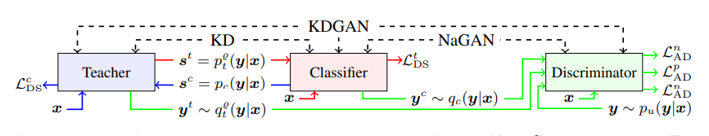
Knowledge Distillation
Distill knowledge from a trained model to a another (smaller) model
Common method: Teacher & Student
Conditional GANs are easier to distill from

Slide 3
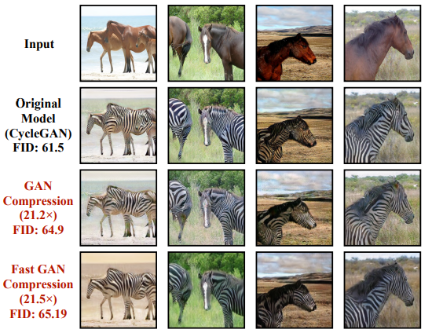
The Goal
Distill knowledge from a big GAN to a smaller GAN while maintaining comparable outputs
Finding the “minimal” model size for a given GAN model

Slide 4
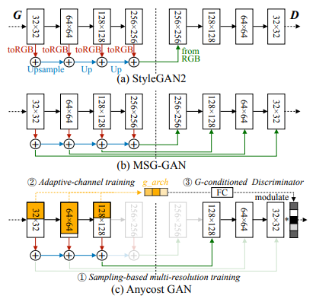
Related Work
Anycost-GAN: Reviewed in our paper presentation
GAN Compression: Efficient Architectures for Interactive Conditional GANs paper

Slide 5
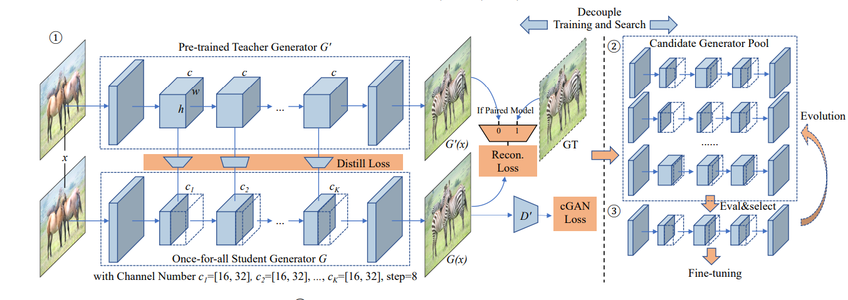
GAN Compression: Efficient Architectures for Interactive Conditional GANs

Slide 6
Our Approach

Slide 7
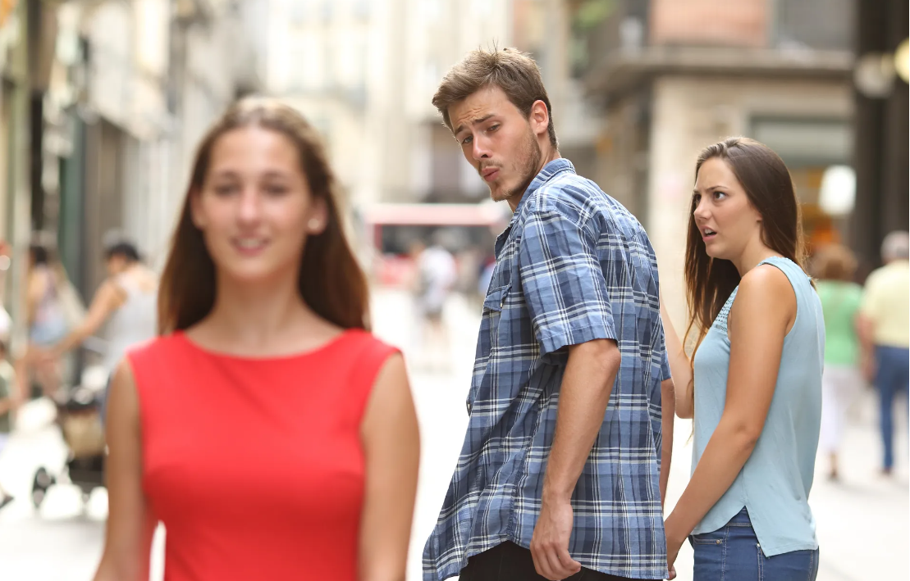
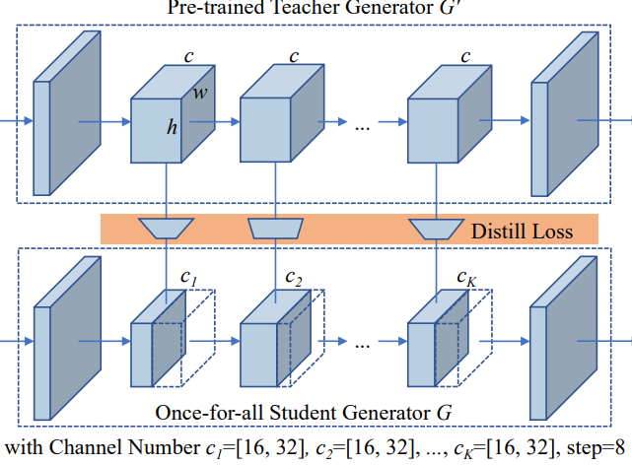
A Minimal Model
Suppose we keep the StyleGAN2 architecture. Can we find minimal channel capacities yielding comparable results?
How can we claim a model is “minimal”?
The Other Model
Me
The Model I Found

Slide 8
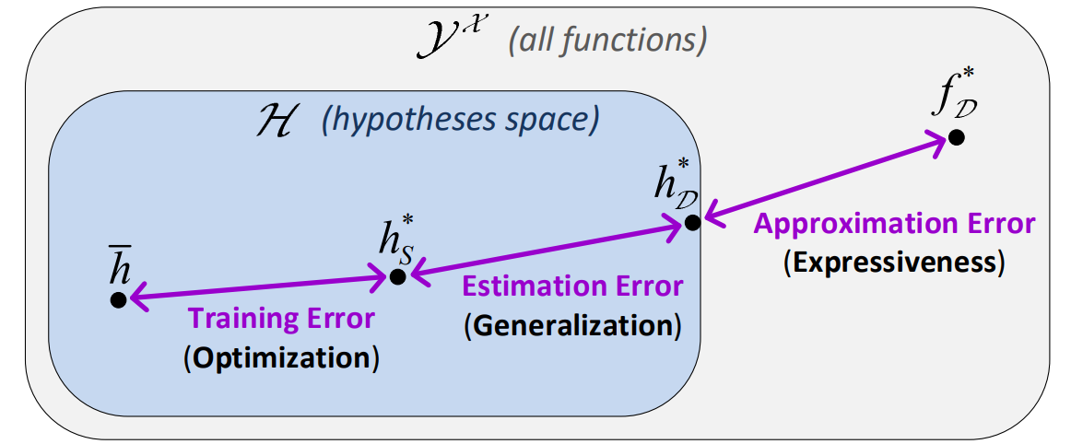
Breaking Up the Problem
Suppose we keep the StyleGAN2 architecture. Can we find minimal channel capacities yielding comparable results?
How can we claim a model is “minimal”?
Converged Model
Minimal Model of Given Architecture
Minimal Model

Slide 9
Breaking Up the Problem
Previous methods optimized student architectures directly.
We split process into 2 phases:
Converged Model
Minimal Model of Given Architecture
Minimal Model

Slide 10
Breaking Up the Problem
Previous methods optimized student architectures directly.
We split process into 2 phases:
Upper bounding the minimal architecture
Training a student model
Converged Model
Minimal Model of Given Architecture
Minimal Model

Slide 11
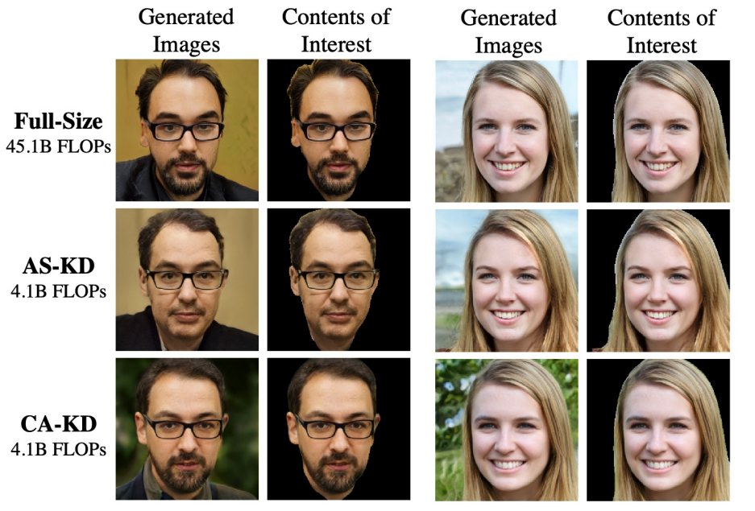
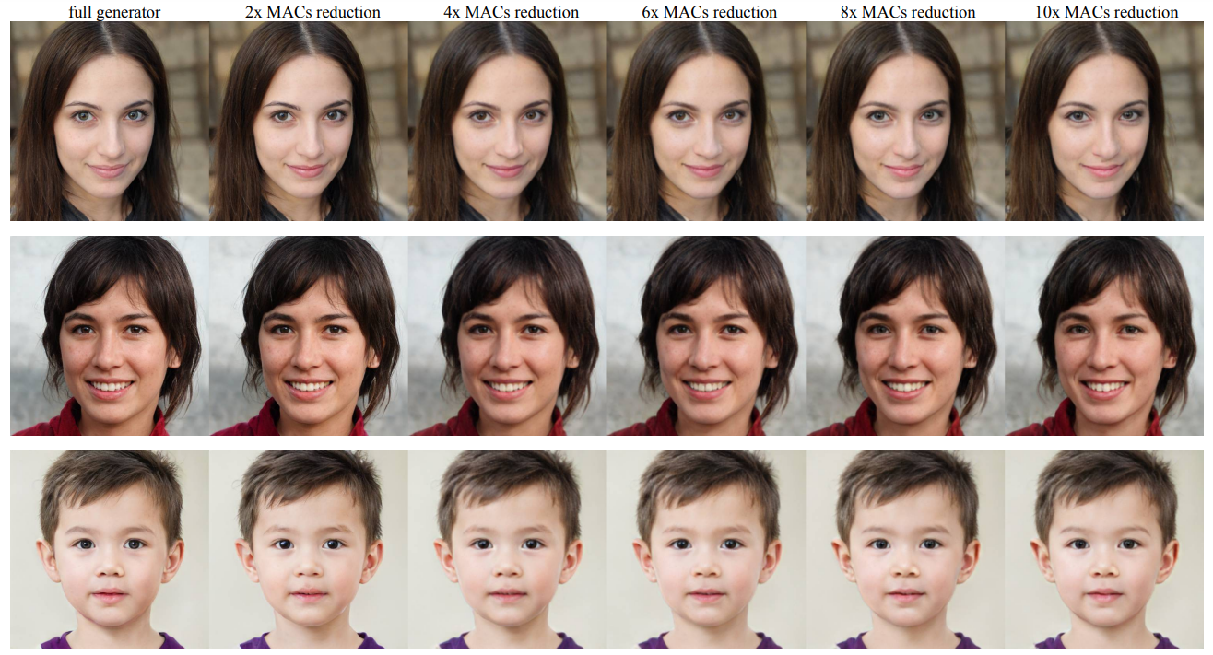
Bounding the Minimal Architecture
Empirical results show that good smaller models exist: (AnyCost, CA-GAN, FitNets)

Slide 12
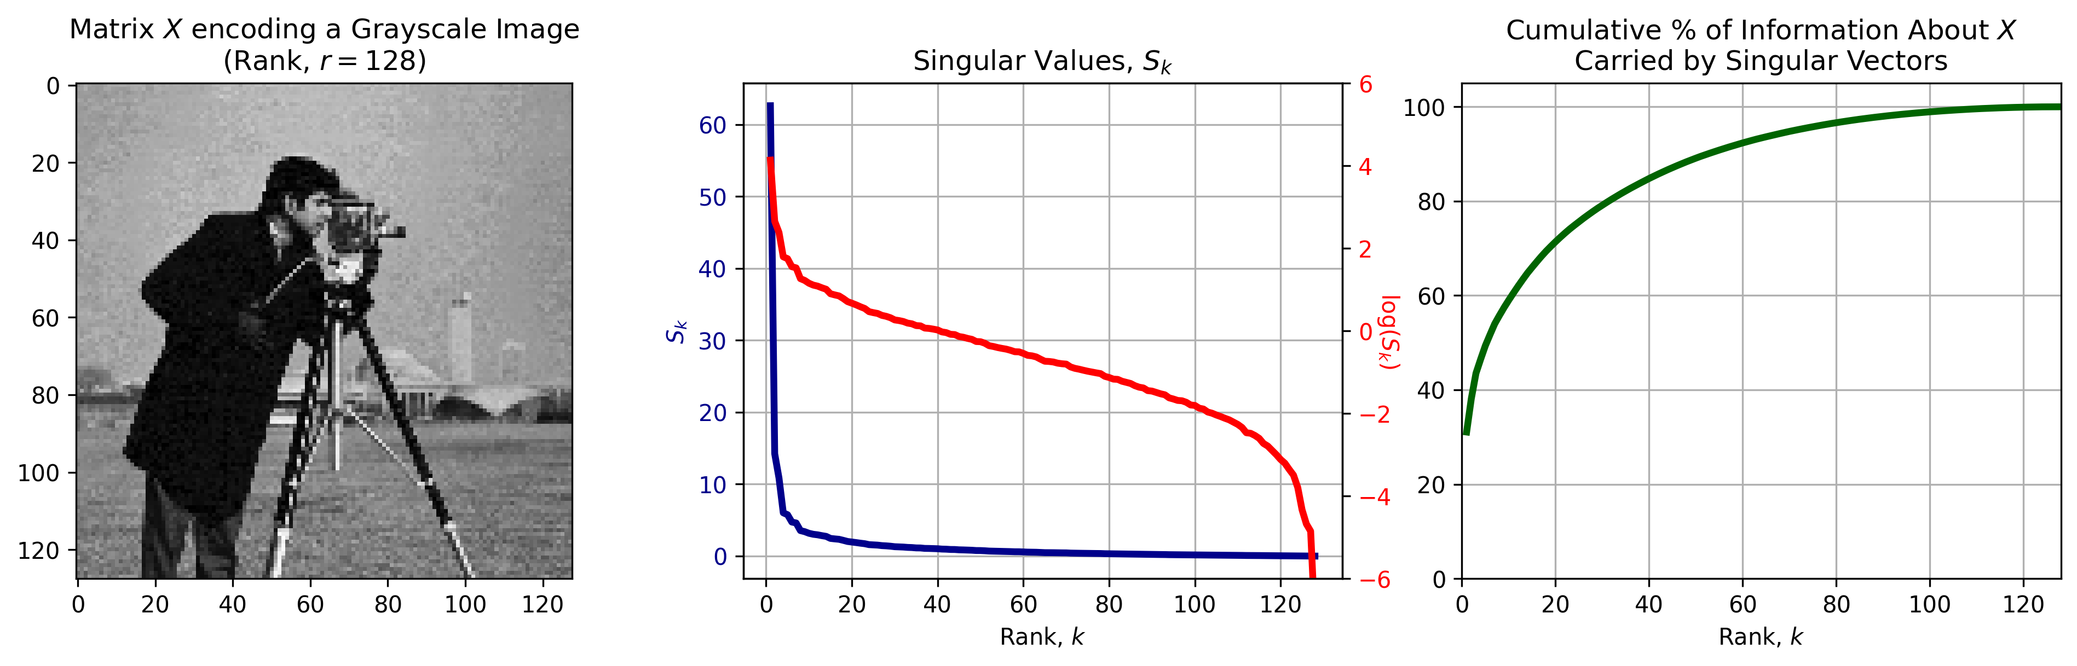
Bounding the Minimal Architecture
Empirical results show that good smaller models exist: (AnyCost, CA-GAN, FitNets)
This suggest some kind of redundancy between convolutional channels.
We focus on low-rank approximability (linear dependence).

Slide 13
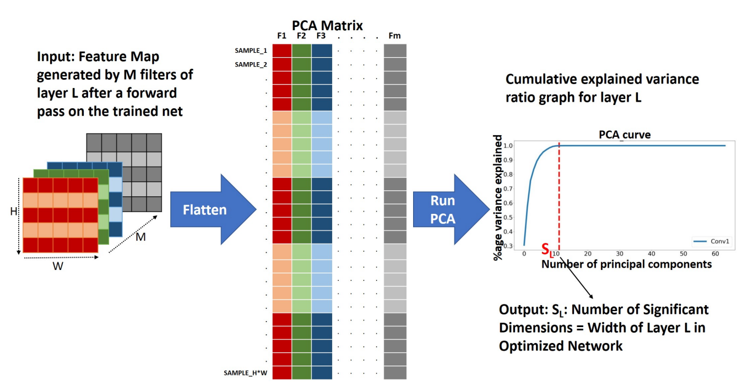
A “Theoretical” Bound

Slide 14

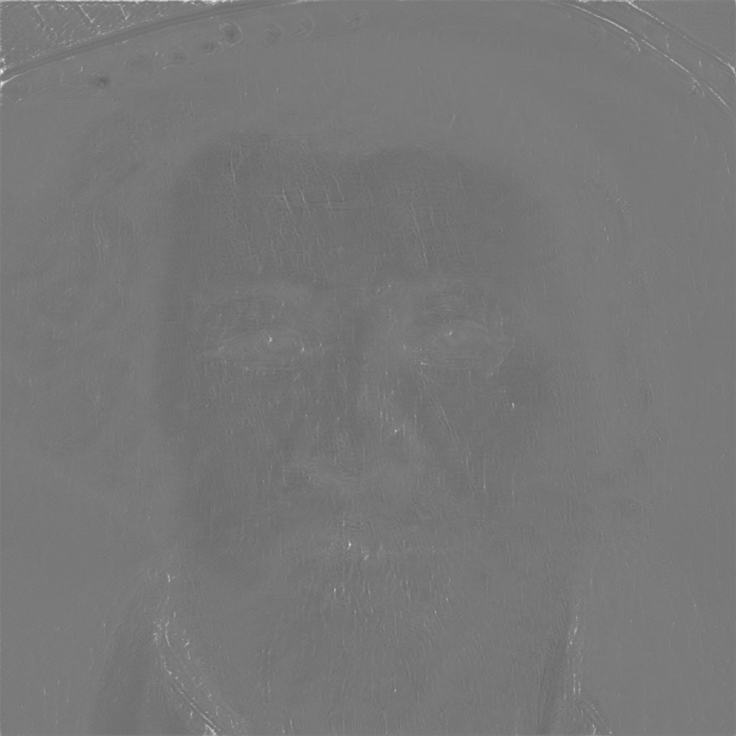
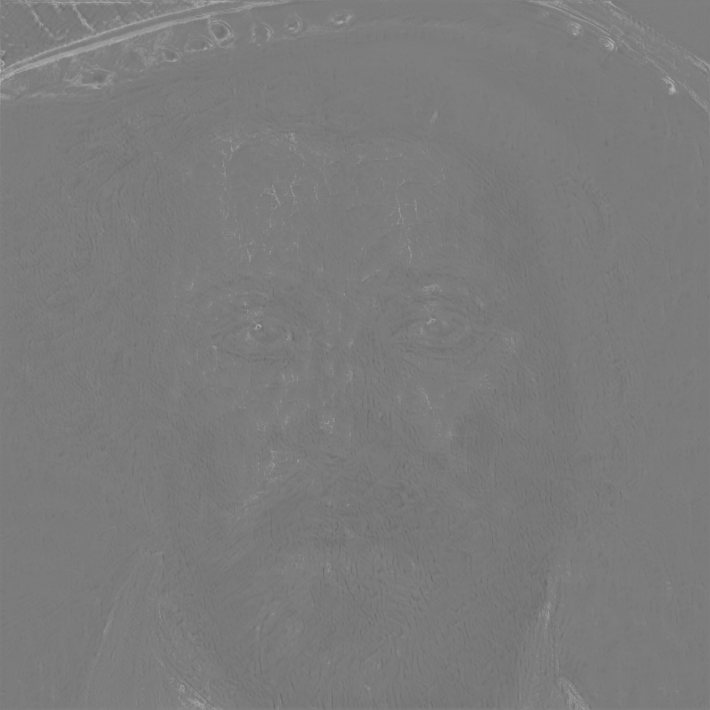
A “Theoretical” Bound

Slide 15
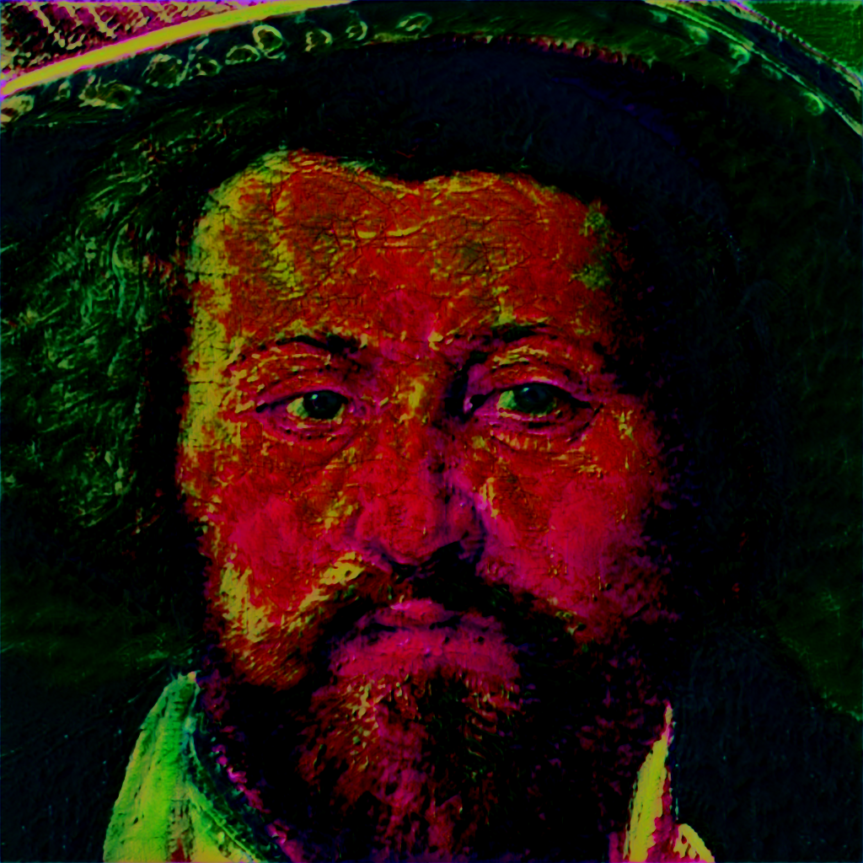
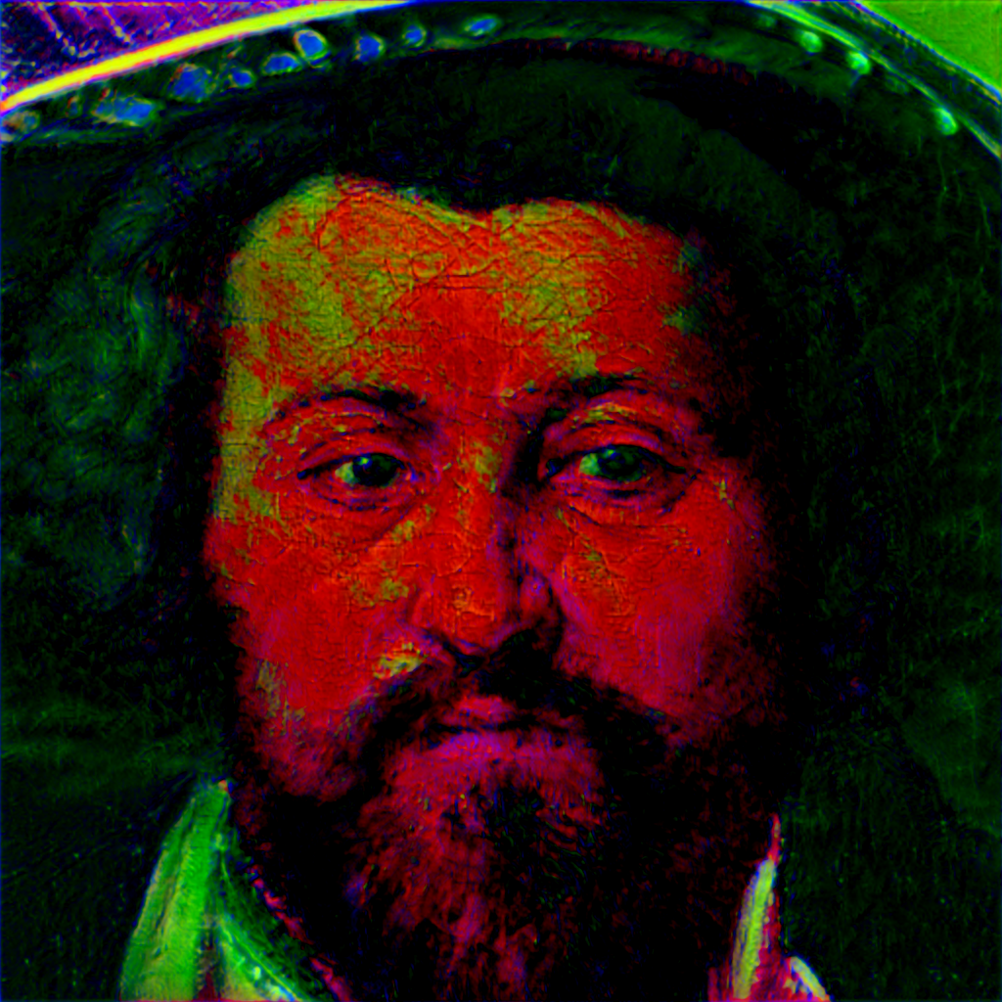
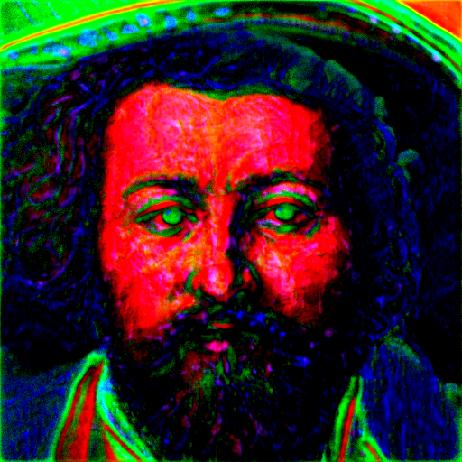
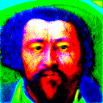



A “Theoretical” Bound

Slide 16
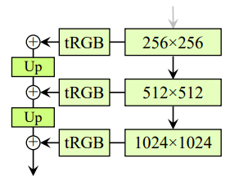
An Learning Based Bound
Take a pre-trained StyleGAN2 model. Freeze all its weights.
At the end of each block introduce a 1x1 convolutional bottleneck.
L2 loss

Slide 17
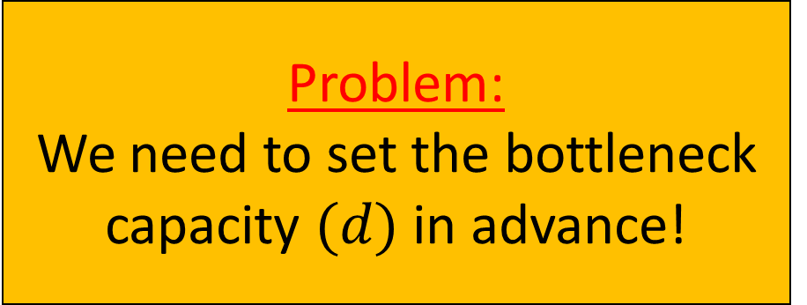
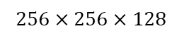
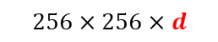
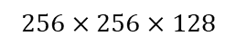
An Empirical Bound
Take a pre-trained StyleGAN2 model. Freeze all of its weights.
At the end of a convolutional block, introduce a 1x1 convolutional bottleneck.
$$256×256×128$$
L2 loss
$$256×256×d$$
$$256×256×128$$
Problem:
We need to set the bottleneck capacity $(d)$ in advance!

Slide 18
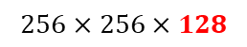
An Empirical Bound
Take a pre-trained StyleGAN2 model. Freeze all of its weights.
At the end of each block introduce a 1x1 convolutional bottleneck. We begin with a “trivial” bottleneck.
$$256×256×128$$
L2 loss
$$256×256×128$$
$$256×256×128$$
$$ℒ\left(G^{′};G, w\right)=ℒ_{recon}\left(G^{′}\left(w\right), G(w)\right)+λℒ_{recon}\left(B\left(G^{\left(L\right)}(w)\right),G^{\left(L\right)}(w)\right)$$

Slide 19
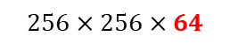
An Empirical Bound
Take a pre-trained StyleGAN2 model. Freeze all of its weights.
At the end of each block introduce a 1x1 convolutional bottleneck. We begin with a “trivial” bottleneck.
Preform adaptative channel training on subsets of this bottleneck.
$$256×256×128$$
L2 loss
$$256×256×64$$
$$256×256×128$$
$$ℒ\left(G^{′};G, w\right)=ℒ_{recon}\left(G^{′}\left(w\right), G(w)\right)+λℒ_{recon}\left(B\left(G^{\left(L\right)}(w)\right),G^{\left(L\right)}(w)\right)$$

Slide 20
Distillation
Training guided by activation similarity to styleGAN
Activation similarity with 1x1 conv (standard)
Tradeoff between accuracy and complexity
L2 loss
L2 loss

Slide 21
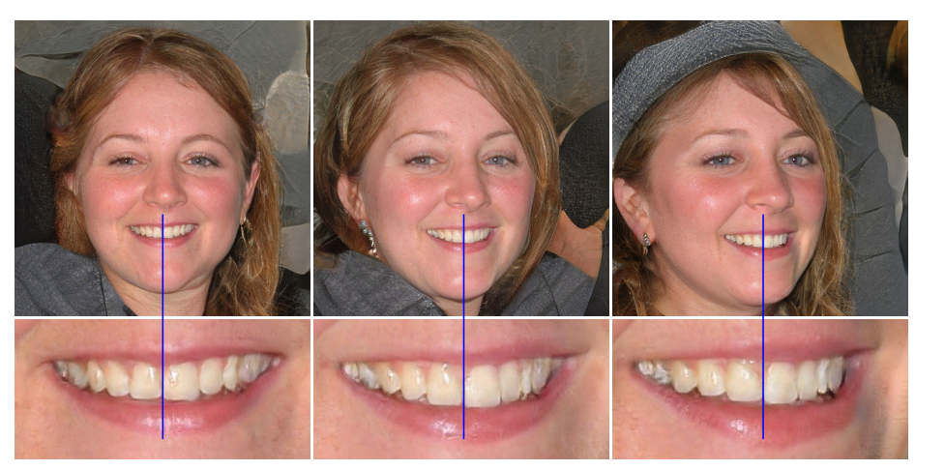
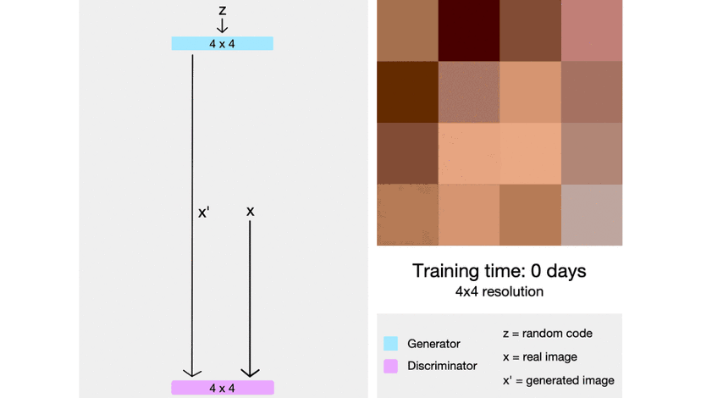
Progressive Distillation
Older versions of GANs used progressive training but the newer versions doesn’t, problems in training

Slide 22
Discriminator
In our basic setup we don’t use it
Could make better results
Harder and longer to train
Maybe only in the final training

Slide 23
Improve Activation Comparison
Architecture (3X3, non linearity)
Loss (L1, L2)

Slide 24
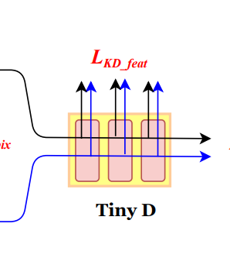
Training Process And Loss
After each level train also the all network?
Do we want to keep the loss from the previous tasks small? exponential decay?

Slide 25
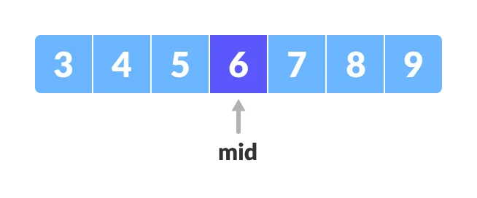
Finding Better Upper Bound
Bottleneck architecture
Binary search

